Slide 1
Computer Ethics LECTURE # 6

Slide 2
Fair Use Notice
The material used in this presentation i.e., pictures/graphs/text, etc. is solely intended for educational/teaching purpose, offered free of cost to the students for use under special circumstances of Online Education due to COVID-19 Lockdown situation and may include copyrighted material - the use of which may not have been specifically authorized by Copyright Owners. It’s application constitutes Fair Use of any such copyrighted material as provided in globally accepted law of many countries. The contents of presentations are intended only for the attendees of the class being conducted by the presenter.

Slide 3

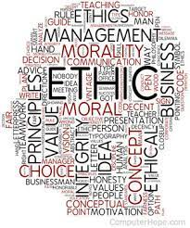
Computer Ethics
Computer ethics is a term used to describe the ethical principles and moral dilemmas that one can encounter in today’s computer-based society.

Slide 4
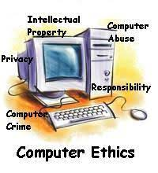
The Commandments For Computer Ethics
You shall not use a computer to harm other people.
You shall not interfere with other people’s computer work.
You shall not snoop around in other people’s files.
You shall not use a computer to steal.
You shall not use a computer to bear false witness.
You shall not copy or use proprietary software for which you have not paid.
You shall not use other people’s computer resources without authorization or proper compensation.
You shall think about the social consequences of the program you write or the system you design.
You shall use a computer in ways that show consideration and respect for your fellow humans.

Slide 5
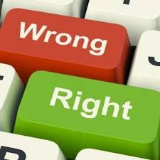
Components Of A Personal Code Of Computer Ethics
Several essential components of a personal code of computer ethics:
Honesty
Respect
Confidentiality
Professionalism
Responsibility
Communication
Obeying the law

Slide 6
Copyright Software Piracy Public Domain
Some software is free to use, copy, and/or change, but only do so if there is written notice that the software is in the public domain. Look for this notice in the “read me” files that accompany programs.
General Public License GPL software has the same restrictions as public domain software, but cannot be sold for profit.

Slide 7
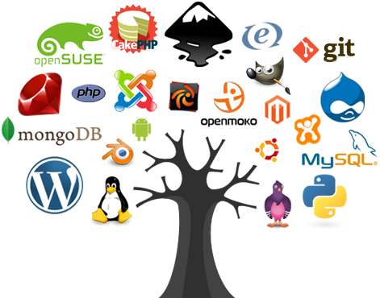
Shareware is commercial software/programs that is distributed free to users, but it is illegal to copy or modify them without permission since they are copyrighted. Most shareware programs are really trial versions of the software, which must be paid for after the trial period has expired. When you purchase a copy of a software program you are actually buying a software license, or in the case of an organization that needs many copies, a site license. A software license can only be copied for backup purposes while site licenses let the organization make a specific number of copies to be used within that organization only. Although it seems common, software piracy is a felony and shouldn’t be taken lightly.

Slide 8

Lesson For Life

Slide 9
Thank you… Questions….??? If Any…

